Slide 1
USER INTERFACES FOR
EMBEDDED SYSTEMS
Lecture 4: Data Gathering
Stefan Wagner
sw@eng.au.dk

Slide 2

OVERVIEW
Two main aims:
    1) Understanding as much as possible about: Users, tasks, context-of-use
    2) Produce a stable set of requirements
This is achieved by:
    Data gathering activities
    Data analysis activities
    Writing and agreeing of requirements
    Should be done iteratively

Slide 3
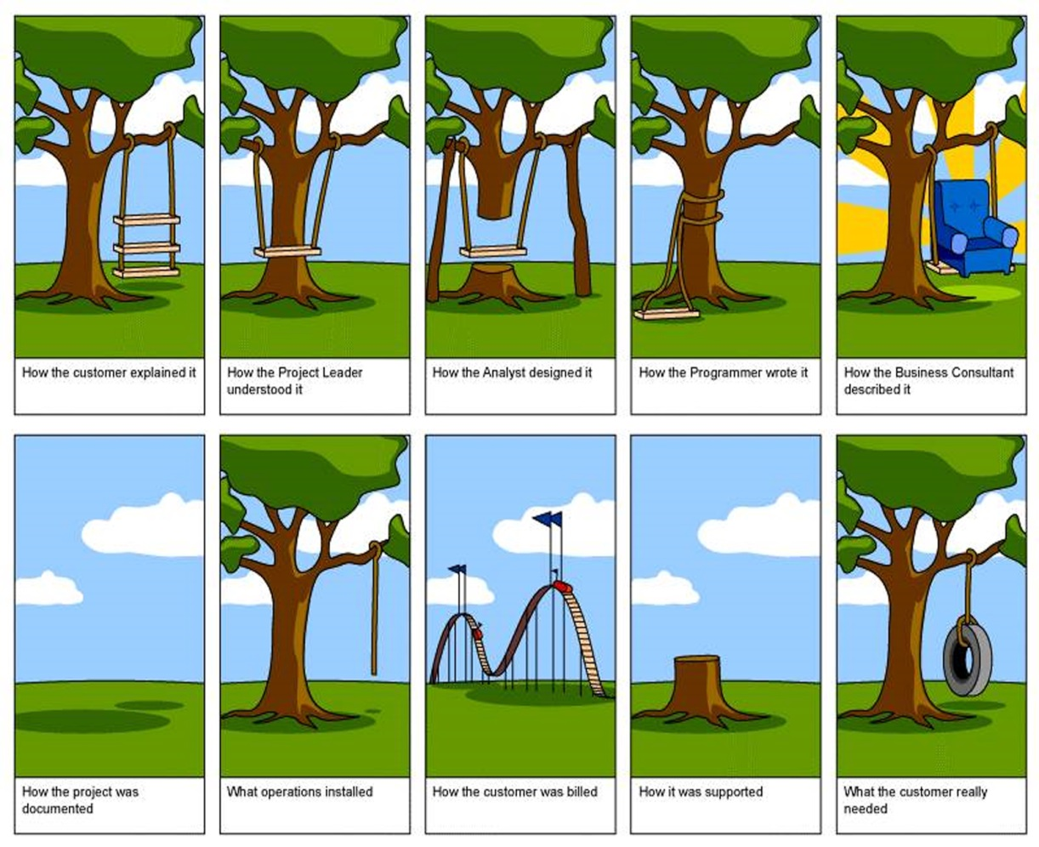
WHAT, HOW, AND WHY?
  Requirements definition: the stage where failure occurs most commonly
  Getting requirements right is crucial

Slide 4
DATA GATHERING FOR REQUIREMENTS
  Interviews:
      Props, e.g. sample scenarios of use, prototypes, can be used in interviews
      Good for exploring issues
      But are time consuming and may be infeasible to visit everyone
Focus groups:
    Group interviews
    Good at gaining a consensus view and/or highlighting areas of conflict
    But can be dominated by individuals

Slide 5
DATA GATHERING FOR REQUIREMENTS
Questionnaires:
    Often used in conjunction with other techniques
    Can give quantitative or qualitative data
    Good for answering specific questions from a large, dispersed group of people
Researching similar products:
    Good for prompting requirements
Studying documentation:
    Procedures and rules are often written down in manuals and instructions
  Good source of data about the steps involved and any regulations
  Not to be used in isolation
  Good for understanding legislation, and getting background information
    No stakeholder time, which is a limiting factor on many other techniques

Slide 6
DATA GATHERING FOR REQUIREMENTS
Direct observation:
    Gain insights into stakeholders’ tasks
    Good for understanding the nature and context of the tasks
    But, it requires time and commitment from a member of the design team, and it can result in a huge amount of data
Indirect observation:
  Good for logging current tasks
Diary:
  An indirect observation technique
  Ask the user to keep a Diary for 1-10 days
  Good for getting an understanding of everyday activities of the users

Slide 7
DATA GATHERING FOR REQUIREMENTS
Contextual Inquiry:
    An approach to ethnographic study where user is expert, designer is apprentice
    A form of interview, but at users’ workplace (workstation) 2 to 3 hours long
    Four main principles:
      1) Context: see workplace & what happens
      2) Partnership: user and developer collaborate
      3) Interpretation: observations interpreted by user and developer together
      4) Focus: project focus to understand what to look for
Shadowing:
      Quite similar to contextual inquiry
      Main principles:
      Follow the user around during half a day, or a full day, depending on context (work, home, on the move)
      Ask questions to learn more on observed activites
      Record on audio if feasible, else take research notes.

Slide 8
CHALLENGES IN DATA GATHERING
Identifying and involving stakeholders:
    users, managers, developers, customer reps?, union reps?, shareholders?
Involving stakeholders:
    workshops, interviews, workplace studies, co-opt stakeholders onto the development team
Who are the ‘real’ users?
    not managers, not marketing, not expert users, not engineers
Political problems within the organisation
Dominance of certain stakeholders
Economic and business environment changes
Balancing functional and usability demands

Slide 9
BASIC GUIDELINES
  Start with identifying stakeholders
  Focus on identifying the stakeholders’ needs
  Involve all the stakeholder groups
  Involve more than one representative from each group
  Use a combination of data gathering techniques
  Support the process with props such as prototypes and interim task descriptions
  Always think iteratively – start with one or more pilots
  You will need to compromise on the data you collect and the analysis to be done
  Consider carefully how to record the data
  Perform data analysis close after data gathering has ended
  Data analysis should result in Tasks (e.g. Scenarios) and Personas

Slide 10
TASK DESCRIPTION
Can be described in different ways:
  1) Scenarios
      An informal narrative story, simple, ‘natural’, personal, not generalizable
      Well suited for end-users, especially non technical competent stakeholders
  2) Use cases
      Assume interaction with a system
      Assume detailed understanding of the interaction
      Well suited for technical competent stakeholders
  3) Essential use cases
      Abstract away from the details
      Does not have the same assumptions as use cases

Slide 11
PERSONAS
Capture user characteristics
Not real people, but synthesized from real user characteristics
Should not be idealized
Bring them to life with a name, characteristics, goals, personal background
Develop multiple personas to cover all approaches

Slide 12
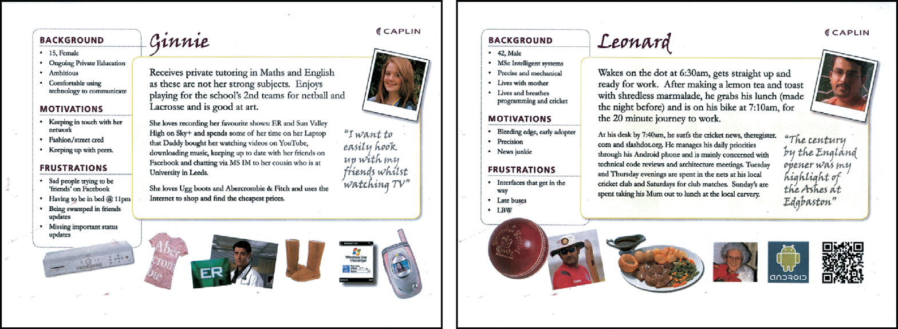

Slide 13
COURSE PROJECT
If you have chosen the standard project
    - Use the standard text and adapt it to real scenarios
Identify stakeholders
    - From your project description
Plan Shadowing and initiate Diary
Create Personas
  - For all your users / stakeholders
Create Scenarios
  - No need to create use cases

